Slide 1
Progress Meeting

Slide 2
Timeline
Phase I [Mid-evaluation (Jan 20) ]
Literature survey
Experiment design
Observations
Phase II [March]
Algorithm I design (KTI -> Metrics)
Algorithm II design (Metrics -> Diagnosis)
Phase III [April]
Results
Conclusion
Phase IV [April]
Thesis writeup

Slide 3
Functional diagram
Monitoring and Control
Send control commands wirelessly
Receiver
Motor driver
Motor
PWM, DIR
Control motor
Receive encoder information wirelessly
Feedback info

Slide 4
Battery
11.1V
Implementation diagram
11.1V supply
Buck
5V supply
Motor
RHINO 60RPM 40KGCM 12V DC PLANETARY GEARED QUAD ENCODER SERVO MOTOR
Publish motor control command and receive encoder information
PWM,
DIR
Motor driver
MD 10C R3
Rpi
esp32
Feedback from encoder

Slide 5
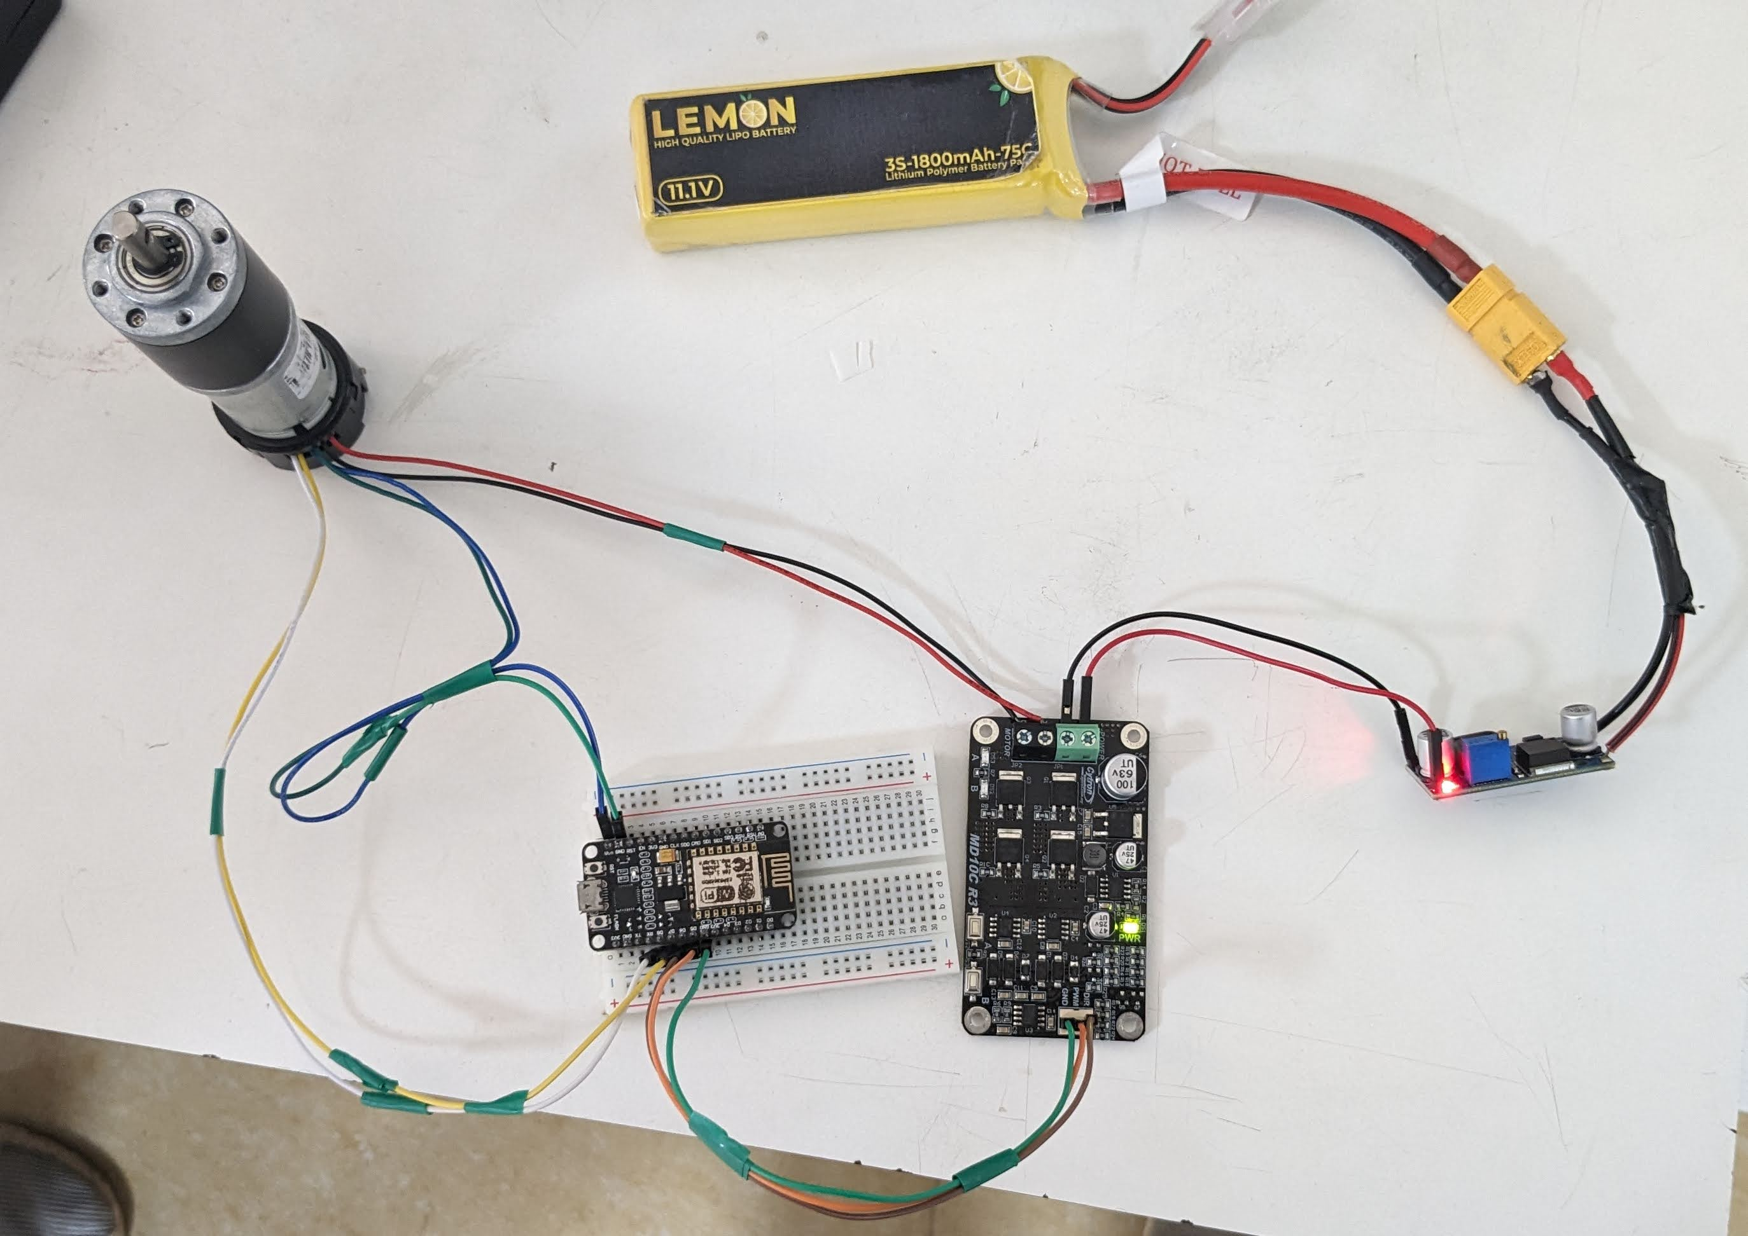
GND
VCC
DIR
PWM
+
-

Slide 6
Pin diagram
MD10C R3
ESP8266
+
+
+
+
Battery
Buck
_
_
_
_
GND
GND
PWM
D5
DIR
D6
D7
_
D8
+
GND
VIN
A
B
Motor
+
_
GND
VCC

Slide 7
Data to be collected
CPU usage of Rpi
Information from esp8266 {Network activity, commands received and published}
Memory usage of Rpi
Network activity of Rpi
Command given to motor from Rpi
Information received from esp8266
Temperature of the esp8266, Rpi, motor

Slide 8
Safety KTI
Temperature of physical devices, Commands sent and recieved
Cybersecurity KTI
CPU usage, Memory usage, Network activity,

